Slide 1
Emergency Medical Drone Design Overview
Melody Lyu

Slide 2

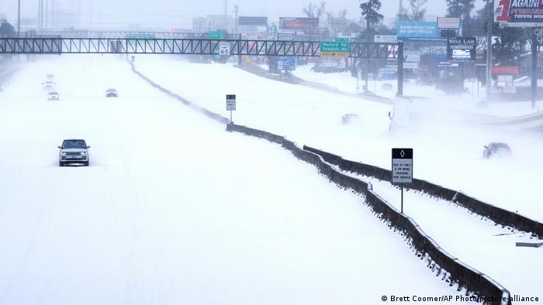
Project Background
Inspired by Natural Disaster such as Hurricane Harvey and winter snowstorm in Texas
Proposed the customer senior capstone project, recruited peers, and secured findings from the Walker Entrepreneurship Program at Texas A&M University.
Problem Statement
Design a climate-controlled unmanned aerial vehicle (UAV) storage container capable of securely, reliably, and accurately storing and delivering prescriptions and vital medications to patients in urban environments.
Hurricane Harvey Causing Catastrophic Flooding in Houston, August 2017
Snowstorm Causing Power Outage in Texas, February 2021

Slide 3
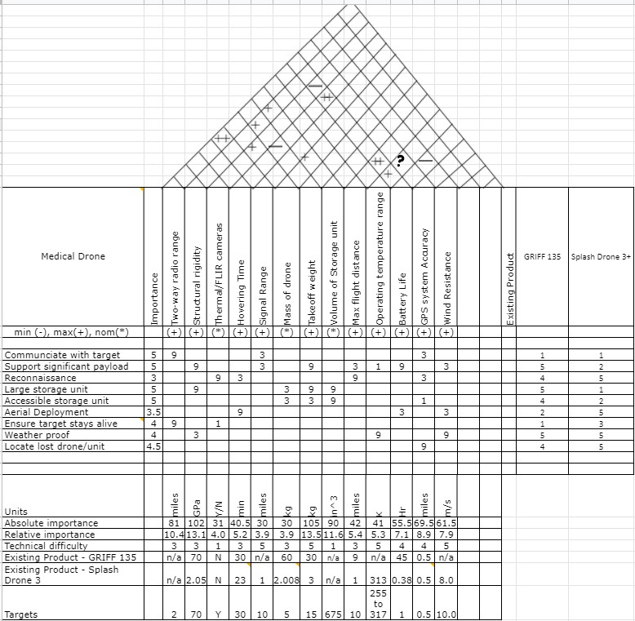
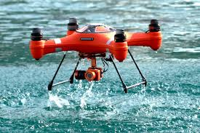
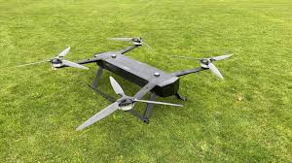
HOQ Analysis
Performed a House of Quality Analysis and compared with existing products.
Major Components
Customer Needs
Metrics
Correlation Matrix
Existing Product analysis
Importance and Specifications
Waterproof Drone “Splash Drone 3+”
Important Metrics
Takeoff Weight
Structural rigidity
Volume of Storage unit
Correlation Ratings
Little Correlation = 1
Medium Correlation = 3
Strong Correlation = 9
Heavy Duty Drone “GRIFF 135”
Notes:
Eric

Slide 4
House of Quality Results / Project Goals
Using the calculated HOQ results, specific metrics target of the drone were set:
Takeoff Weight
Less than 5 kg
Footprint
Less than 200 in²
Time to Deploy
Between 4 to 6 seconds
Cost
less than $1,100
Range
Between 1 to 3 miles
Necessary
Desirable
Notes:
Eric

Slide 5
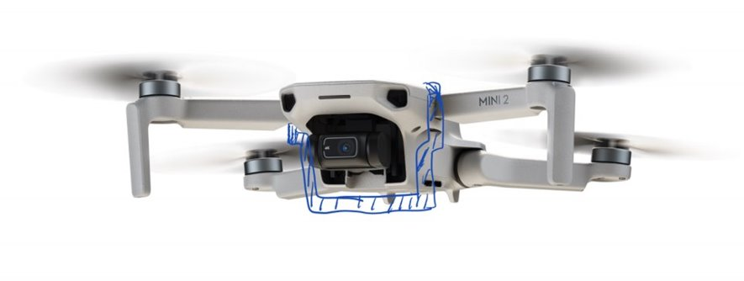
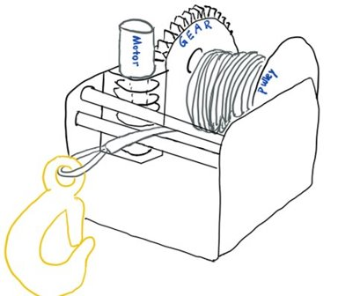
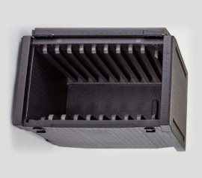
Selected Design after Brainstorming
Mavic
3D Printed Bracket for Release Mechanism on an example drone
Pulley System will be attached at the bottom of the drone
Optional Package for medical supplies that required to be temperature controlled: ​
Expanded Polypropylene Insulation case
Optional Package:
Expanded Polypropylene Insulation case for temperature control
Pulley System Design
Notes:
Ethan – The Mavic drone was used because it is the best drone on the market. It is fast, can travel long distances, however it was to expensive

Slide 6
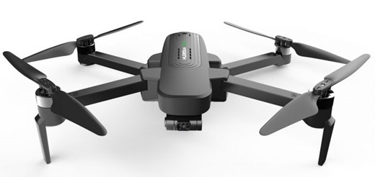
Embodiment Design - Drone
Hubsan Zino Pro Plus
Affordable Price ($ 500)
Customizable for connecting to the release mechanism
Hubsan Zino Pro Plus
Notes:
Ethan
The Mavic drone was used because it is the best drone on the market. It is fast, can travel long distances, however it was to expensive which is why we switched to zino drone

Slide 7
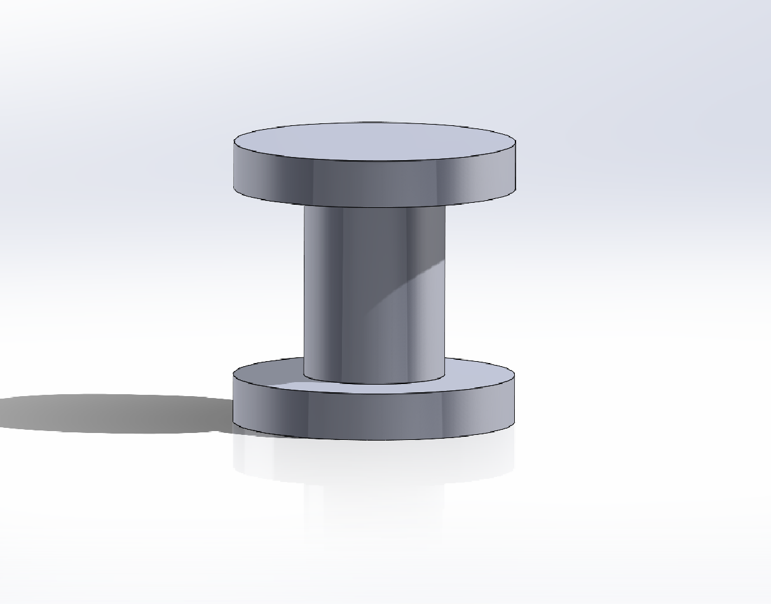
Embodiment Design – Pulley Spool & Rope
Pulley’s Spool:
Geometry: Circular
Material : ABS
Width: 3.81 cm
Outer Radius: 1.91 cm
1:2 Ratio for Inner to Outer Diameter
Rope:
Fishing Line
Tensile Strength: 485 MPa
Yield Strength: 241 MPa
Weight and Tensile Strength specifications met
Attached to hook and around spool of pulley
Pulley’s Spool
Notes:
Jehonathan

Slide 8
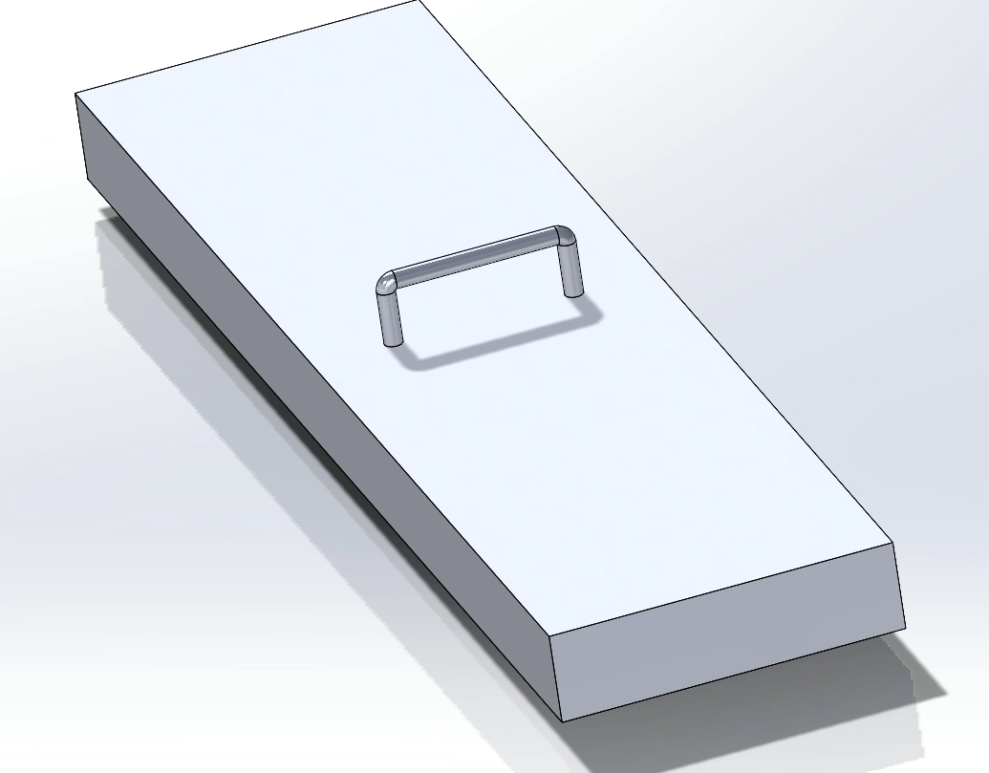
Embodiment Design – Clasp for Velcro Attachment
Velcro Square Loop
Material: ABS (Lighter than PLA)
Size
Height: 1 cm Tall
Length: 15 cm
Width: 4 cm
Handle:
Width: 2 cm
Height: 0.7 cm
Plastic Bracket:
FDM 3D Printing
Material: ABS (Lighter than PLA)
Geometry: Rectangular
Plastic Bracket
Notes:
Mention housing components

Slide 9
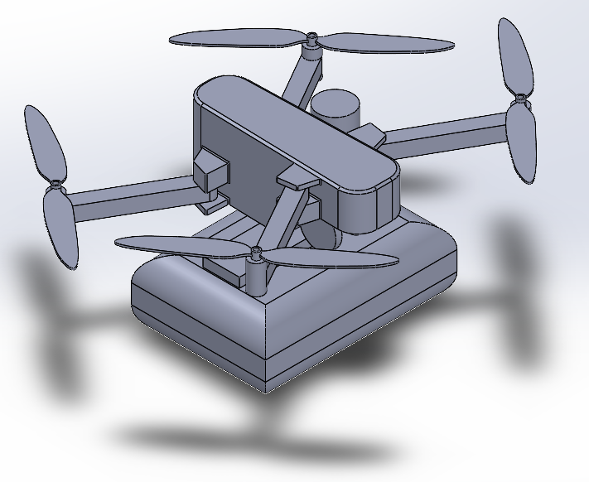
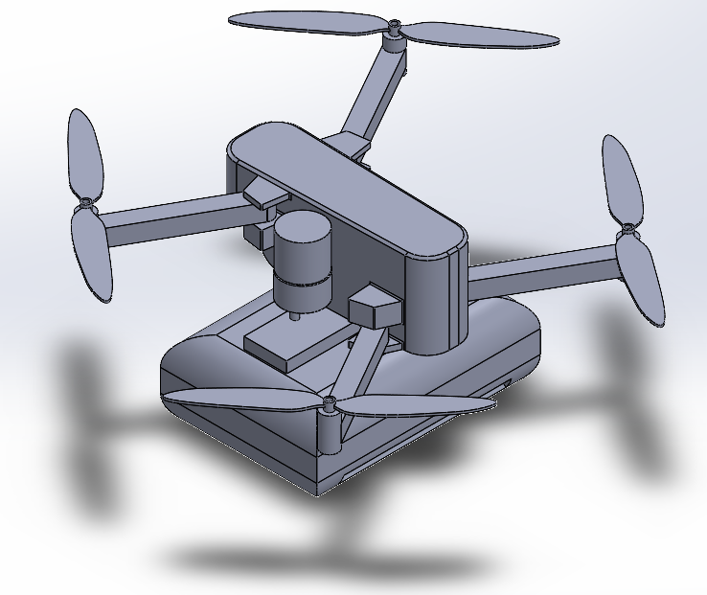
Embodiment Design – Digital Model
Isometric Views of Emergency Medical Drone mockup
Notes:
Allen

Slide 10
Work Breakdown Structure
Ordering Material
Construct Release Mechanism Prototype
Test Release Mechanism Prototype
Construct Drone
Test Drone Payload
Update Drone Motors
Microcontroller Set-Up
Electric Circuit board testing
Construct Plate for Storage Unit
Test Securing Plate
Connect Release Mechanism With Controller
Test for Time to Deploy
Connect Plate with Release Mechanism
Test Drone Assembly
Operational Manual
CAD drawing
FEA Analysis
3D Printing Drone Bracket
Notes:
Mel
On top of planning the budget for the project we have also generated a work breakdown structure In order to ensure our project bulilding process goes smoothly next semester. A CAD drawing is already created by Allen, We plan to run FEA analysis on our design, and prepare for 3d printing using the current CAD drawing. for the next step, we will order materials, and construct the main components such as drone, release mehcanism and storage unit connected to the system. All of these tasks are going to be seperated and become weekly deliverables next semester.

Slide 11
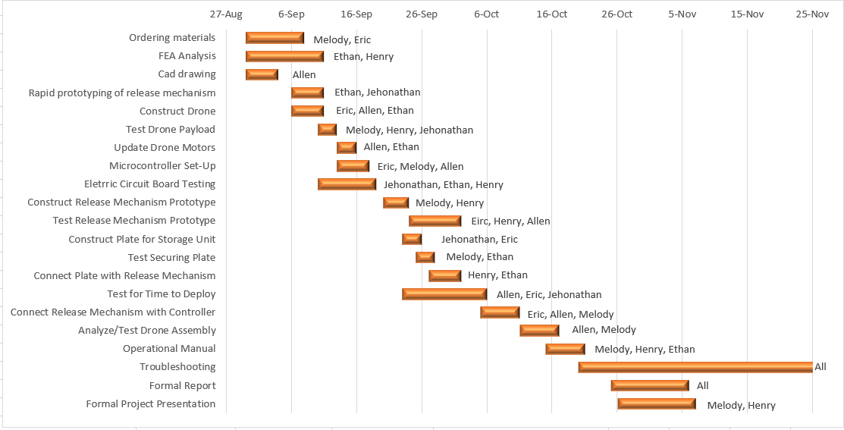
Gantt Chart for Building Prototype
Oct 1st - Mid Term Project Evaluation
Nov 1st – Scheduled Project Due Date
Nov 2nd – Nov 26th Troubleshooting Period
Notes:
Mel
Next, we have concluded the project timeline for next semester, including weekly deliverables we mentioned in work breakdown structure, and some milestones such as the mid term project evaluation date on Oct 1st, and scheduled project due date Nov 1st. As mentioned before, we are planning on having a month of trouble shooting period in December incase of anything goes wrong.

Slide 12
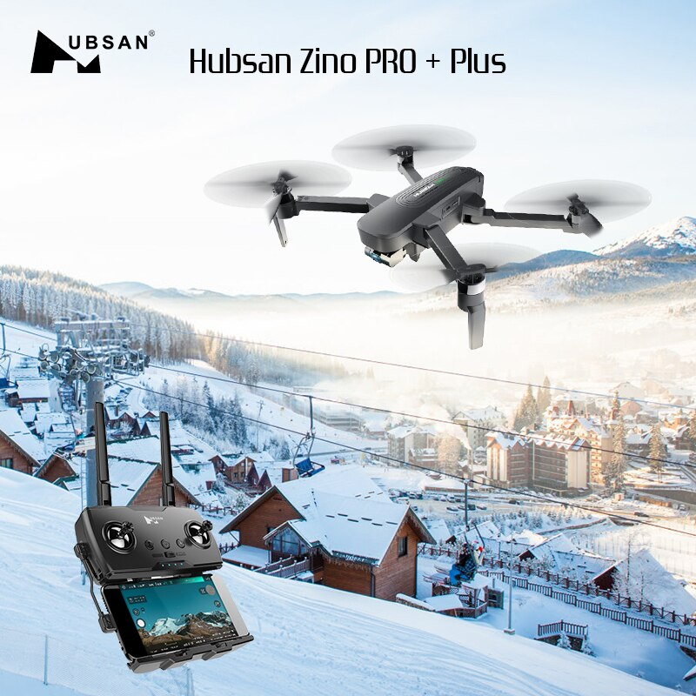
Future Work
FEA Analysis
Construct Full Prototype
Connect Drone/Controller to Release Mechanism
Validation Testing
Project Demonstration Video
Operational Manual
Hubsan Zino Pro Plus
Notes:
Mel
failure modes and effects analysis (FMEA)

